Slide 1

Graduate Admissions Systems Optimization Task Force - Update
Graduate Directors Meeting
September 26, 2024
Notes:
Perhaps one or two others can speak to one or more of the slides, especially in the recorded presentation?
→ → Please add presentation date or month, and/or any subtitle, in the small-print section in the middle.

Slide 2
Agenda
Overview of Task Force charge and status
Systems review and status
Stakeholder engagement thus far
Demo targets
Initial system map
Pivotal pain points and key functions exercise

Slide 3
Systems Optimization Task Force
Graduate Admissions Systems Optimization Task Force Charge:
Assessing Current Systems: Review the current admissions system’s capabilities, strengths, and inefficiencies, with a particular focus on the international application review process, application update process, and overall enrollment management.
Exploring New Solutions: Research potential new systems and system support to improve functionality.
Providing Recommendations: Develop recommendations for potential system upgrades, changes, or migrations, with an emphasis on optimizing workflows, improving user experience, and ensuring scalability.
Notes:
is tasked with evaluating and improving the University of South Carolina’s graduate admissions systems. The charge of the task force includes:

Slide 4
Systems Optimization – Roadmap
September
Collate system requirements
October
November
Report collation
Initial vendor meetings with Task Force
Interviews with key stakeholders
Share recommendations with University Leadership, AAGDC, Grad Directors, Graduate Council
Collate cost estimates
Final and follow-up Task Force vendor meetings
Community surveys
Community surveys
Stakeholder and reference interviews
Community-wide meetings with 2 vendors
Open forum for community feedback
Complete system requirements/cost estimates
Prioritize system requirements
System mapping

Slide 5
Systems Optimization Task Force
Questions to Answer
What application systems are available and appropriate for USC consideration?
What criteria should be used to evaluate these application systems?
What system is recommended and why?
What are the technology and software implications of recommendation?

Slide 6
Stakeholder Engagement THUS FAR
18 interviews concluded, an additional 12 scheduled/ongoing
Arts & Sciences (Humanities & Sciences)
Engineering
Information & Communications
IT
Music
Nursing
OIRAA
Public Health
Registrar’s Office

Slide 7
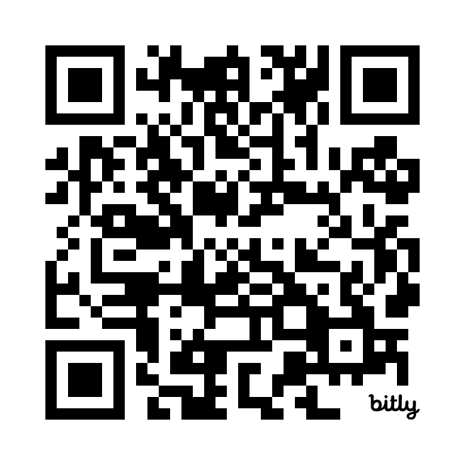
Stakeholder Engagement THUS FAR
Want to meet? Schedule here!
Central administration
CRM managers
Graduate Directors
Graduate School coordinators
Program administrators
Recruiters
Technical support

Slide 8
Important demo feature/functions
Ease of use/customization and user-friendly interface – through the application process
Communication capabilities
Centralized data tracking; data reporting; data flexibility/customizability
Confidentiality and security in the review process
Batch uploading of documents
International applicant processing
Enrollment progression tracking

Slide 9
Important demo feature/functions
Ease of use/customization and user-friendly interface – through the application process
Communication capabilities
Centralized data tracking; data reporting; data flexibility/customizability
Confidentiality and security in the review process
Batch uploading of documents
International applicant processing
Enrollment progression tracking

Slide 10
System Scenario
Recruit/Prospective Applicant
In-Progress/Applicant
Applicant for Consideration (aka Applicant Review)
Admitted Applicant
Pre-Matriculant
Student

Slide 11
Other Scenarios
Recruit/Prospective Applicant
In-Progress/Applicant
Applicant for Consideration (aka Applicant Review)
Admitted Applicant
Pre-Matriculant
Student
= manual process or no process in place at all

Slide 12
Findings thus far
A myriad of systems out there to manage different stages of the student life cycle, primarily prospect, applicant, applicant review, student
Motivations vary for system selection; reasonable to expect our solution will likely need to accommodate continued use of many of the current systems in place

Slide 13
Applicant
Entry Point
Type 1:
Prospect & Applicant
Management
Student
Application
All manual
Prospect
Entry Point
Type 2:
Application &
Enrollment Progression
Sometimes manual
Banner
Direct connection
-Event Attendee
-Inquiry Form
-Prospective Applicant
Imported List
Type 3:
Prospect, Applicant, &
Enrollment Progression
CollegeNET
Admission
Decision
Type 4:
Enrollment
Progression
Notes:
System 2:
Prospect, Applicant, &
Enrollment Management

Slide 14
Systems 1, 2, & 3 may offer
functionality to:
Review Applications
Develop/Send
Recommended Admission/
Funding Letters
Manage Pre-Matriculant
Communications
Track Enrollment Progression
Functionality may otherwise be
provided through a specialized system, or a manual process
System 1:
Prospect & Applicant
Management
Student
Application
System 2:
Application &
Enrollment Management
Banner
System 3:
Prospect, Applicant, &
Enrollment Management
CollegeNET
Admission
Decision
Notes:
System 2:
Prospect, Applicant, &
Enrollment Management

Slide 15
SySTEM BREAKDOWN
Prospect & Applicant Management
CollegeNET
Prospect, Applicant & Enrollment Progression
Chemistry database
Applicant & Enrollment Progression
Pub Health database (PhGrad)
Application
ATCAS
BusinessCAS
CASPA
CSDCAS
CollegeNET
PTCAS
Slate
SOPHAS
Internal database
Education database
Slate
Music database

Slide 16
Known Unknowns THUS FAR
Test Score Import Procedure
Graduate Assistantship Application and Selection Process
Forms Management
Recruit/Applicant/Student Stakeholder Perspective
Fellowships and Scholarships Selection and Management
Funding and Financial Aid
Grants Management
Additional systems onboarding in other units

Slide 17
Definitions
Enrollment Management:
A strategic approach that oversees the entire student lifecycle, from recruitment and admissions to retention and graduation. It focuses on optimizing recruitment efforts, admissions processes, financial aid distribution, student support services, and data analysis to meet institutional goals related to student numbers, diversity, and academic success.

Slide 18
Definitions
Admissions: The process of managing and evaluating applications from prospective students, determining their eligibility, and making decisions regarding their acceptance into an institution or program. This includes activities such as reviewing academic qualifications, conducting interviews, and notifying applicants of their admission status.
Enrollment Progression: The ongoing process of tracking and supporting students as they advance through their academic program, from initial enrollment to graduation. It involves monitoring key milestones, such as course completion, academic performance, and credit accumulation, while ensuring that students meet the necessary requirements to continue progressing toward their degree.

Slide 19
ExercisE – Magic Wand
Imagine you have a magic wand and can design the perfect enrollment management system. Each individual should consider the following:
What key features would your ideal system include?
How would it handle the applicant/student experience from start to finish?
What tools or processes would make the biggest difference in admissions and student progression?
Write down your scenario on a piece of paper and turn it over when complete.

Slide 20
ExercisE - Admissions
Think about how your college processes applications and makes applicant decisions. What specific steps are the most time-consuming or error-prone? Where are the bottlenecks?
Write down each challenge on a different sticky note
Craft your observations individually, then we will come together to discuss as a group

Slide 21
ExercisE – Enrollment Progression
Now, consider how you track student progression. What tools or processes are critical for success, and where are the gaps?
Those meeting virtually should work collectively as one discussion group
Those meeting in person should break out into groups of 3-5

Slide 22
ExercisE – Magic Wand
Orient back to your magic wand scenario. With your group, combine your magic wand scenarios to your group’s proposed ideal scenario. Discuss:
How would your scenario address current pain points and improve efficiency?

Slide 23
Notable Pain Points/Pivotal Functions
Manual transfer of data and documents between systems
Flexibility, customizability, and autonomy in real time
Application
Data capture
User Dashboard/Pool Status Awareness
Communication gaps
Notifications/alerts to users and applicants
Awareness of communications across student life cycle
Ease of campaign development
Timeline misalignment
Program admissions/review cycle not aligned with general university timelines
Creates communication & processing challenges

